Slide 1
Prelim Pitch

Slide 2
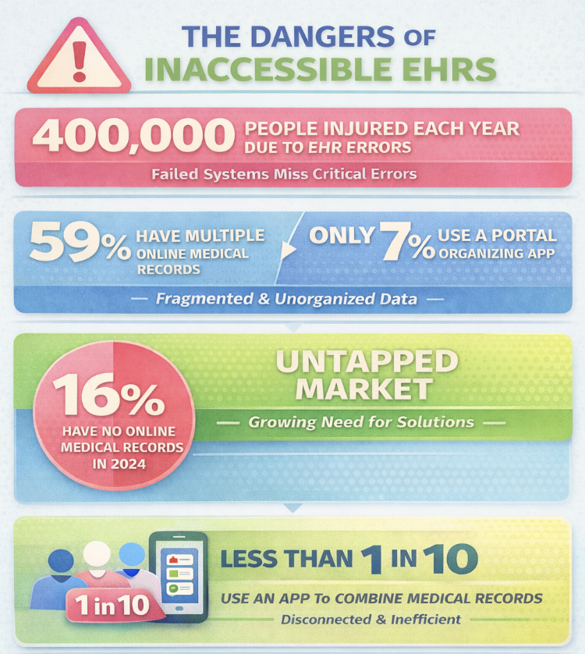
Health care data is fragmented and patients pay the price
Millions of patients struggle with disconnected health records, despite the 21st Century Cures Act

Slide 3
KEY PROBLEMS
In emergencies, new providers lack critical history (allergies, meds, past surgeries) which have led to detrimental errors.
Patients don’t know which out-of-state doctors accept their insurance plan/tier.
EHRs aren’t easily accessible across state lines

Slide 4
ProviderNet exists to eliminate the barriers of geography in healthcare so no information gap, insurance blind spot, or clinical oversight harms patient outcomes.
SOLUTIONS
Deliver easy-to-read summaries to help patients understand their test results and high-level clinical briefs to give providers instant medical context through AI-powered tools
Unify health record and insurance coverage, eliminating healthcare confusion
Guide patients to in-network providers anywhere in the US

Slide 5
VALUE PROPOSITION
Uniting Your Health with the Care You’re Covered for
ProviderNet is the only platform that unifies the healthcare journey into a single workflow. We’ve replaced the digital chaos of multiple portals with one simple login, giving patients and providers a guided care experience that finally transcends state lines.

Slide 6
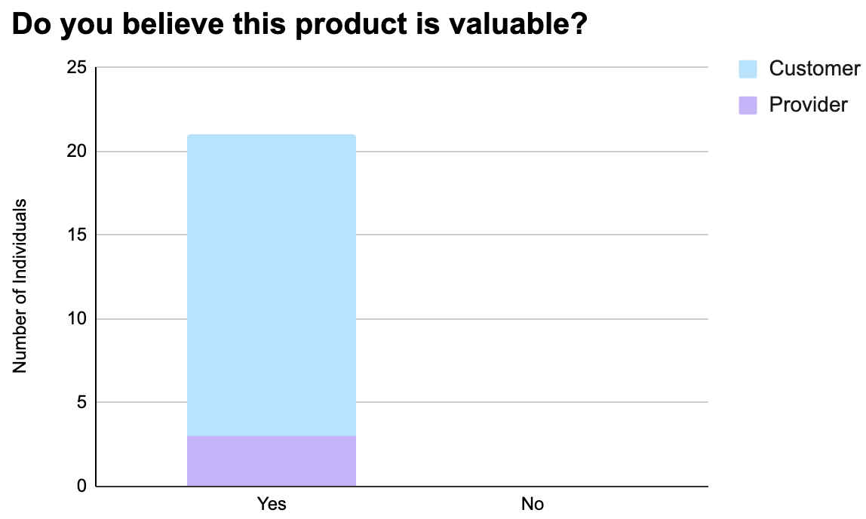
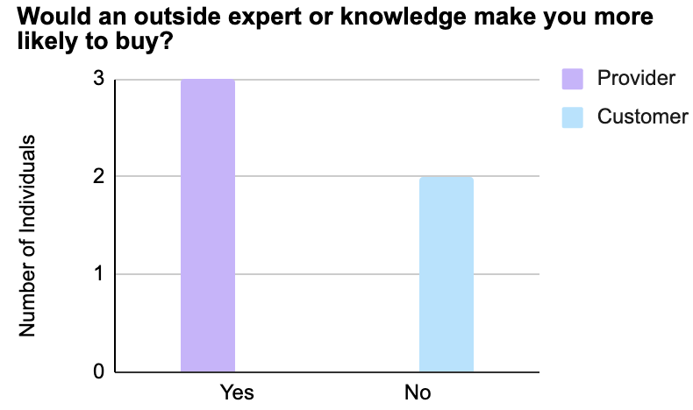
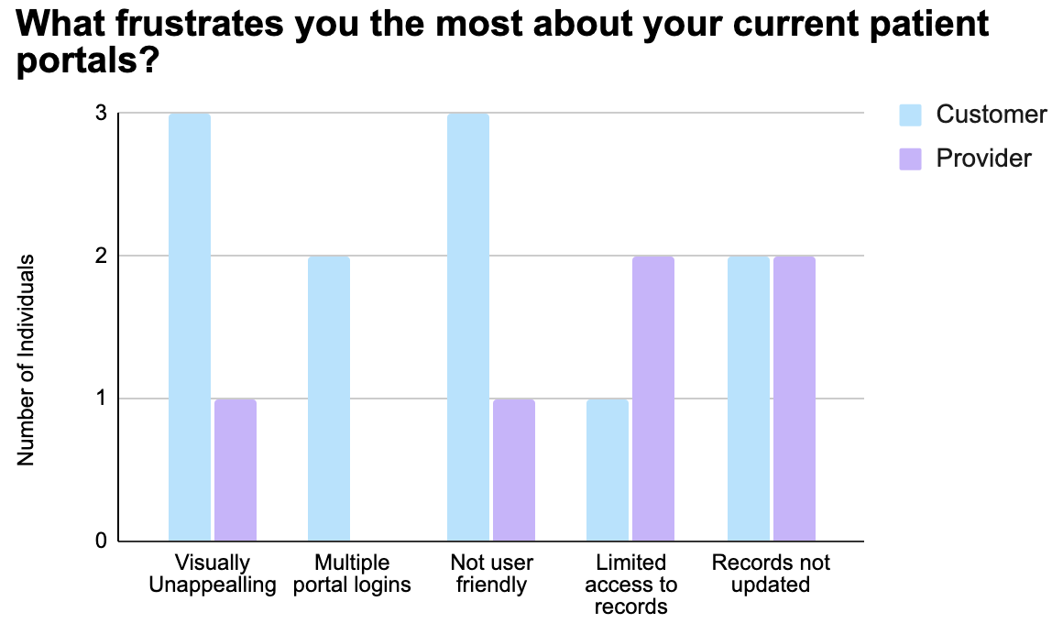
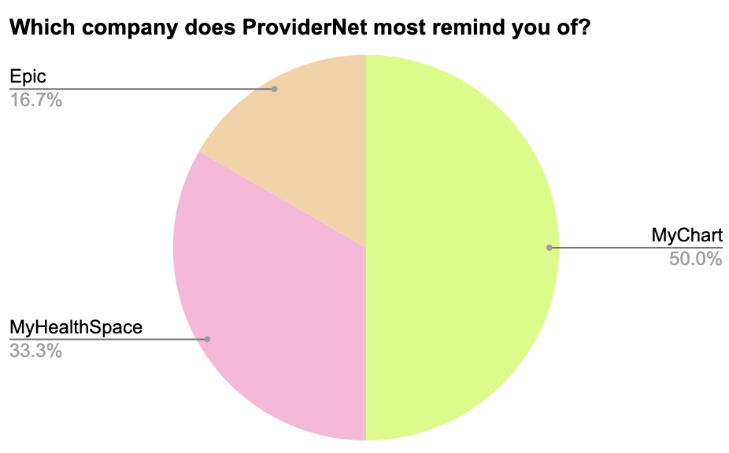
CUSTOMER DISCOVERY

Slide 7
1
2
3
4
5
Company Proposal
Provider Insights
Expert Opinions
AI Usage Disclosure
Competitor Comparison
Gain feedback on company goals, name, and structure
Gain feedback on personal struggles accessing health records (customer and provider)
Inquire about HIPAA compliance and other struggles in actual healthcare facilities
Gain feedback on the usage of artificial intelligence to summarize health record data
Gain insight into our competitive advantage
DISCOVERY ROADMAP
“Do you think this is a product that would be valuable in your life?
“Would having access to all previous health records be beneficial to your practice?”
“What is necessary of a health record data sharing system to be HIPAA compliant?”
“Would the use of artificial intelligence in our company steer you away from usage?”
“Based on the listed attributes from each company, which are you more likely to use?”
“Do you feel the proposed name reflects the company purpose?”
“Have you had issues getting health records from patients you have not seen before?”
“What are current struggles with your company’s electronic health record system?”
“Which company, based on these attributes, do you would think better address your issues?”
“What frustrates you the most about your current patient portals?”
“Which value proposition do you like the best based on our company goal?”
“What company does ProviderNet most remind you of?”
Pricing insights from both the care provider and customer

Slide 8
Total Addressable Market
Serviceable Addressable Market
Serviceable Obtainable Market
BUSINESS MODEL
SWOT
$402.7 Billion
Global Healthcare IT Market
every hospital, physician's office, and insurer worldwide that uses digital systems
$18.1 Billion
US EHRs & Data Exchange Market
90%+ of U.S. providers who have already adopted EHRs but are struggling to make them talk to one another.
$270 Million
Onboard 5,000 providers at $4,500/month
Independent Specialty Groups and Travel
Nursing/Telehealth Networks
These are providers who constantly move across state lines and deal with fragmented records every day. Plan to capture 1.5% of market by 2028
Source: 2025 Grand View Research Market Reports

Slide 9



Jaden Del Rosario
CEO
Lydia Holleman
CTO
Lola Wood
CFO
OUR TEAM
This team member brings a unique blend of scientific expertise and technological insight to executive leadership with both biological and computational skills. As Chief Executive Officer, they drive the strategic direction and long-term vision of the company, leading organizational growth and cross-functional collaborations.
Utilizes background knowledge in biology and bioinformatics, with a particular interest in pursuing future healthcare careers to bridge the gap between life sciences and technology. As Chief Technology Officer, this team member leads infrastructure development, overseeing platform architecture and data security implementation.
With a background spanning bioinformatics, medical data, and product analysis at a major internet firm, Lola brings a scientific precision to our financial leadership. As the Chief Financial Officer, she translates complex R&D and digital product metrics into a robust financial roadmap.

Slide 10
Month 1
Month 2
Month 3
FEB 2026
MAR 2026
APR 2026
OBJECTIVES
Develop brand messaging focused on continuity of care and eliminating geographic barriers in healthcare
Clearly communicate HIPAA compliance, data security standards, and privacy protections
Develop ProviderNet prototype
Run targeted campaigns toward remote workers, seasonal relocators, and telehealth groups
Begin outreach referral to clinics in high-relocation states
Refine pricing model
Launch ProviderNet platform
Establish social media presence focused on digital healthcare innovation to gain traction
Demonstrate real demand for cross-state healthcare continuity
Onboard 5-10 pilot users: mix of patients and small provider offices

Slide 11
Seeking $4 million for 15% stake
40% prototype development, security
30% outsourcing developers for platform maintenance
30% marketing, outreach and launch
Goal: $270 million in revenue by the end of 2028

Slide 12
Notes:
Delete first slide, just do stats, make the numbers the focal point
Less words throughout
Impact of customer discovery, less charts at once
Show the product (app, website, database, etc.)
Takes words off of tam/sam/som just do circles
Why we are the best (leadership and product)
Look at competitor revenue, how they started, what we need to do differently
Focus more on data exchange? So we can merge the information in each systems

